Slide 1
Cloud computing
Channel Overview

Slide 2
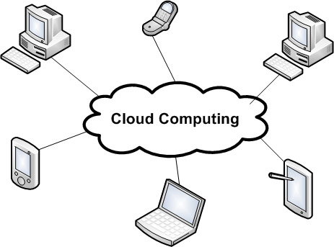
Cloud Computing
Shared resources, software, and information
Elastic Scalability
Ability to access applications remotely via Web
1 to many: one instance to multi-tenant architecture
Notes:
Image Source: http://www.flickr.com/photos/claborne/4553451770/sizes/o/

Slide 3
Architecture
Multiple “cloud components”
Talk to one another over an API (typically web services)
Always available
Easy to maintain
No install

Slide 4
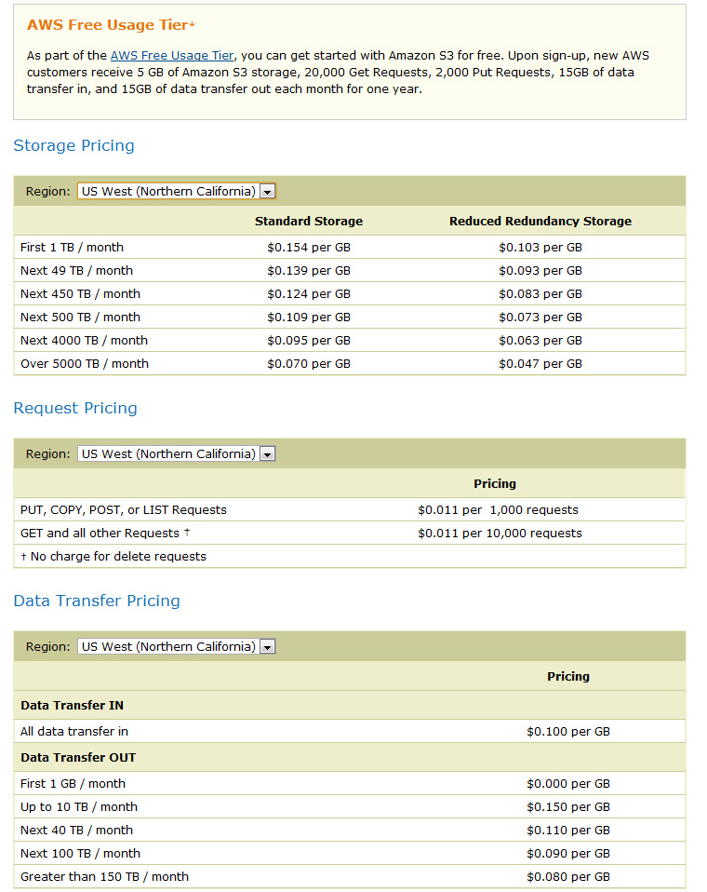
Customers
Subscription based fees
Only pay for resources that they use
Similar to utility services
Resources grow and shrink based on demand
http://aws.amazon.com/s3/#pricing
Notes:
Subscriptions are typically on a monthly or annual basis
Image Source: http://aws.amazon.com/s3/#pricing
Simple Monthly Calculator
http://calculator.s3.amazonaws.com/calc5.html

Slide 5

Example: Amazon S3
Simple Storage Service
Store and retrieve any type or amount of data
Scalable, reliable, speed, low-cost
Notes:
Image Source: http://awsmedia.s3.amazonaws.com/logo_aws.gif

Slide 6

Example: Dropbox
Cloud based automatic file-synchronization services
Users share and store files online
Notes:
Image Source: http://www.dropbox.com/static/images/dropbox_logo_home.png

Slide 7

Example: Google App Engine
Build, Maintain, Scale on Google’s infrastructure
Only pay for what you use
Java and Python environment
Notes:
Image Source: http://code.google.com/appengine/

Slide 8

Example: Windows Azure
Cloud platform to build, host and scale web applications through MS datacenters
Run ASP.NET Web applications or .NET in the cloud
Notes:
Image Source: http://www.microsoft.com/windowsazure/windowsazure/

Slide 9
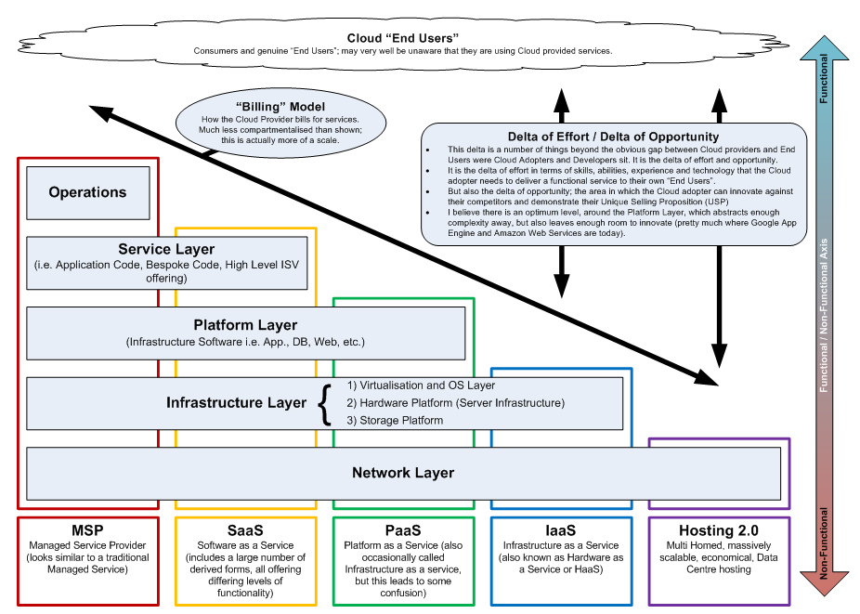
Notes:
Image Source: http://www.flickr.com/photos/48345595@N08/4724759674/sizes/l/

Slide 10
Thoughts?
What Industries / Clients does this work for?
One that contains applications where cost, reliability, and scalability are concerns
Any Ideas?
Any site using UGC
Transfer of large files

Slide 11
Additional Resources
Amazon S3
Dropbox
Google Apps
Microsoft Online Services
Salesforce Cloud Computing
What cloud computing really means

